Slide 1
Hunting Unsigned DLLs
to find APTs
Daniela Shalev
March 18, 2023

Slide 2

WHOAMI
Threat Hunter in Palo Alto Networks
Living in Israel
Served in the Israeli Navy as a Security Researcher
Addicted to Avocado

Slide 3
About the research

Slide 4
Hunting Hypothesis
Attackers will eventually load a malicious module (DLL)
DLLs will be loaded within one of 2 methods -
DLL Hijacking
Using LOLBINS (Rundll32.exe, Regsvr32.exe, etc…)
The DLL will be unsigned
Most of the times, malicious DLLs will be placed in unprivileged paths. I.e: - C:\ProgramData - C:\users\user\documents
- C:\users\user\AppData\...

Slide 5
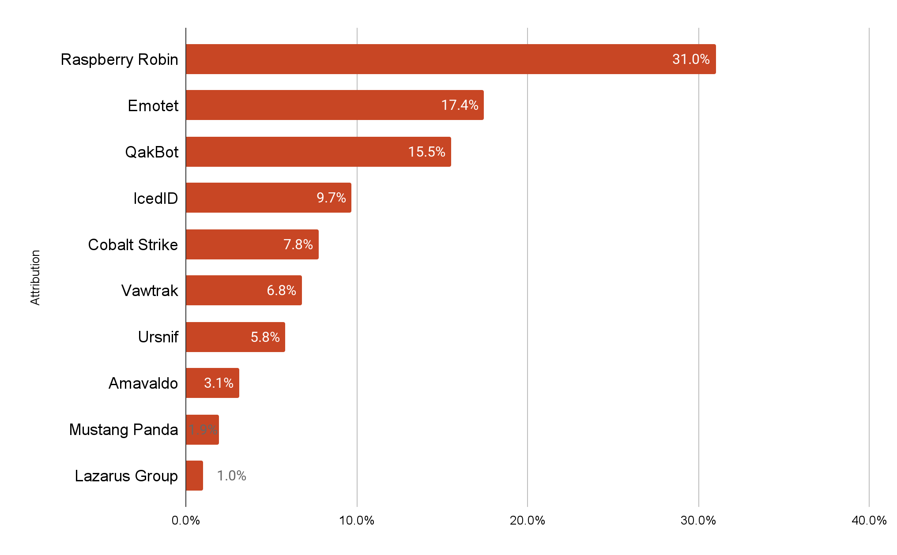
Real Life Scenarios

Slide 6
Real Life Scenarios
Lazarus Group
Raspberry Robin
Mustang Panda

Slide 7
Study Case #1 Lazarus

Slide 8

Lazarus Attack
Lazarus
North Korean Cyber Operators
Targeting the Chemical Sector (recent attacks)
The Victim
A Gas company
Sophisticated Hacking Techniques
Living off the land
Using various samples and techniques
Supply Chain Attack

Slide 9
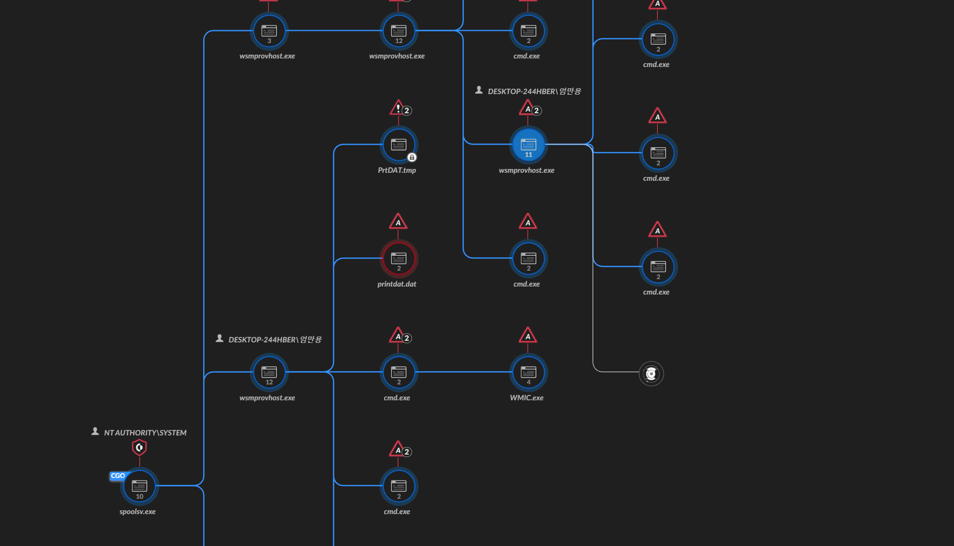
Lazarus Attack
DLL hijacking activity
C:\ProgramData\Intel\wsmprovhost.exe loading unsigned mi.dll

Slide 10
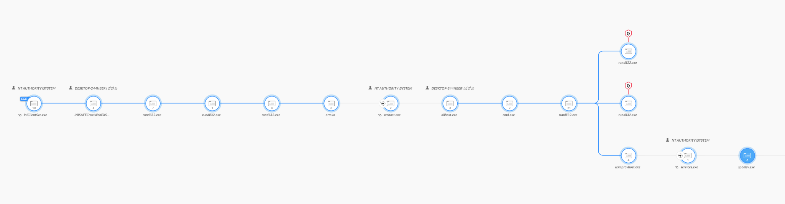
Lazarus Attack

Slide 11
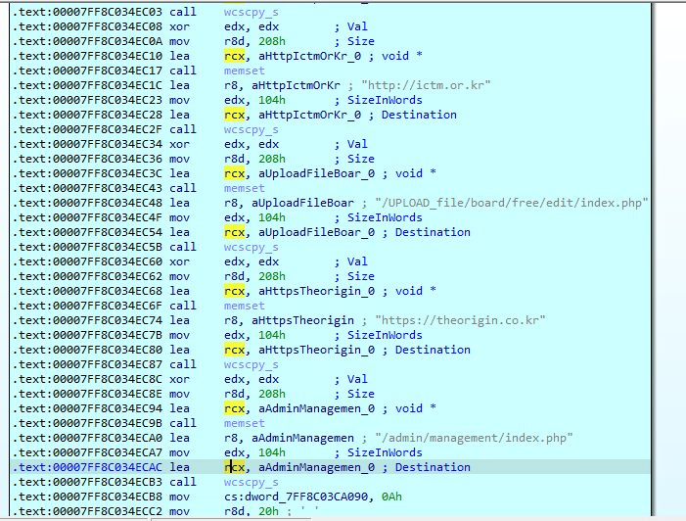
Lazarus Payloads
Executed via DLL Hijacking
Malware implementation inside an open-source self-compiled code (BugTrap)
Dynamically allocated shellcodes
Staged payloads -
Information Gathering
Reverse Shell

Slide 12
Study Case #2 Raspberry Robin

Slide 13
Raspberry Robin
Raspberry Robin -
Published in May by RedCanary
New attacking group
The victims -
Various victims from different sectors
No common product
Hacking Techniques -
Infection vector - USB drive containing a malicious shortcut
Unique payload for each victim
Sophisticated C2 infrastructure
Sophisticated payloads and malwares

Slide 14
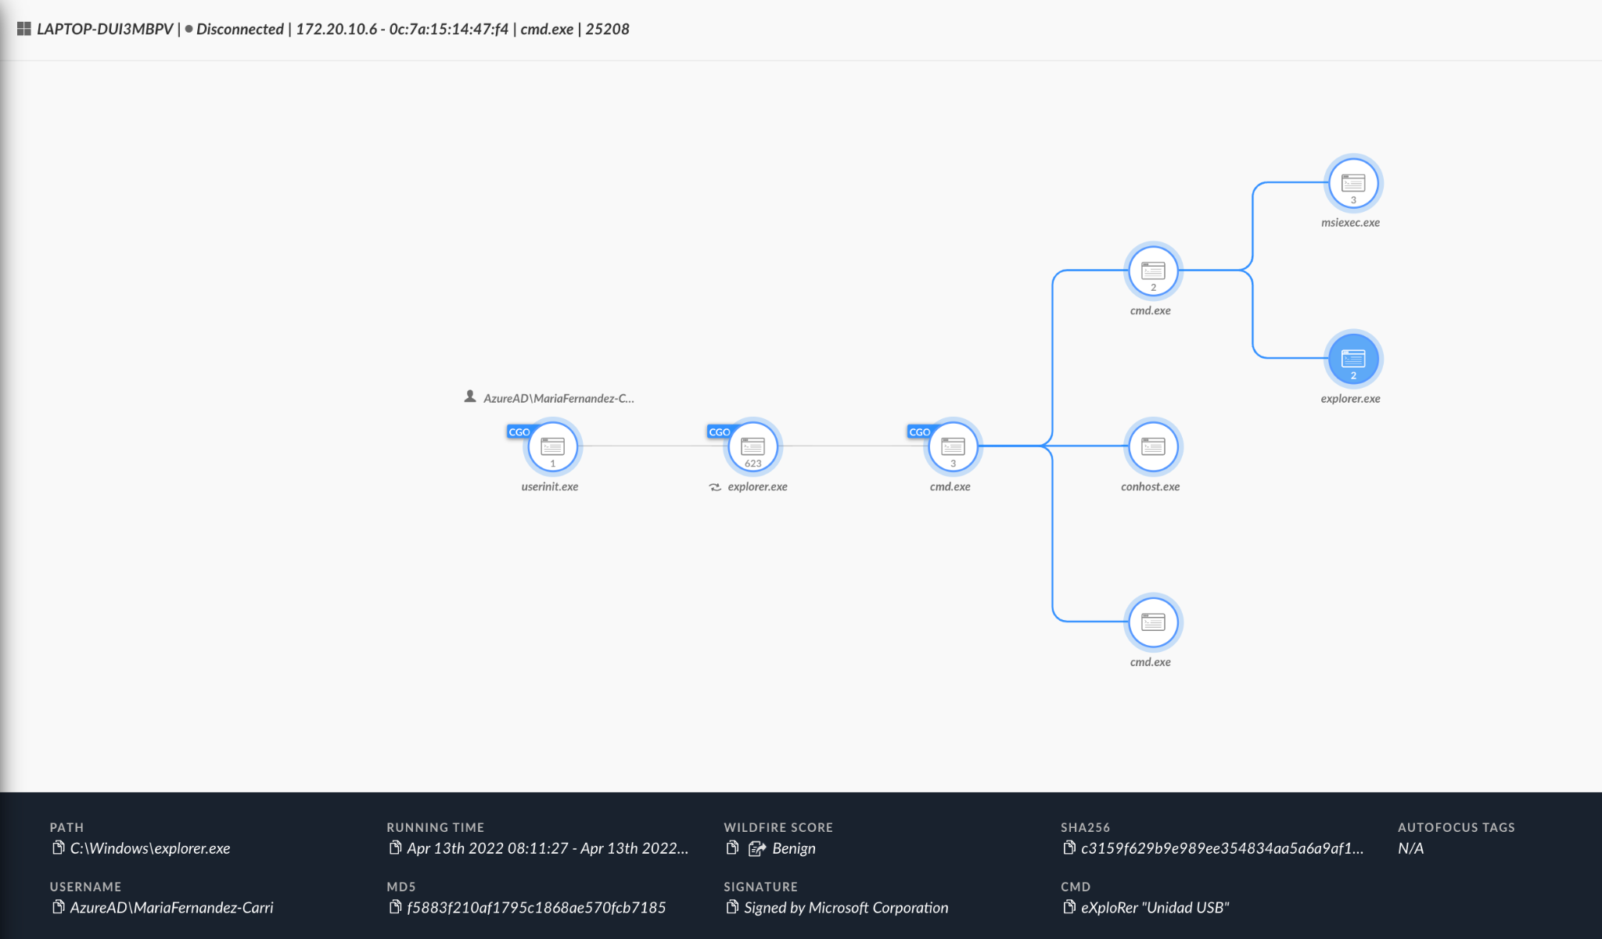
Raspberry Robin
DLL loading using Rundll32 - rundll32 C:\ProgramData\ToolsSoft\NjitHolder\WznSport_l1_qtz32.dll Systeg_Enterpsoft_VisumlD
Process Hollowing
Outgoing communication towards TOR exit nodes
Persistence using scheduled Task or registry run keys

Slide 15
Study Case #3 Mustang Panda

Slide 16

Mustang Panda APT
China-based threat actor
First observed in 2017
Targeting government entities, and non-governmental organizations in the U.S., Singapore, Mongolia, Pakistan, and Vietnam.
Utilizes shared malware like Poison Ivy and PlugX

Slide 17
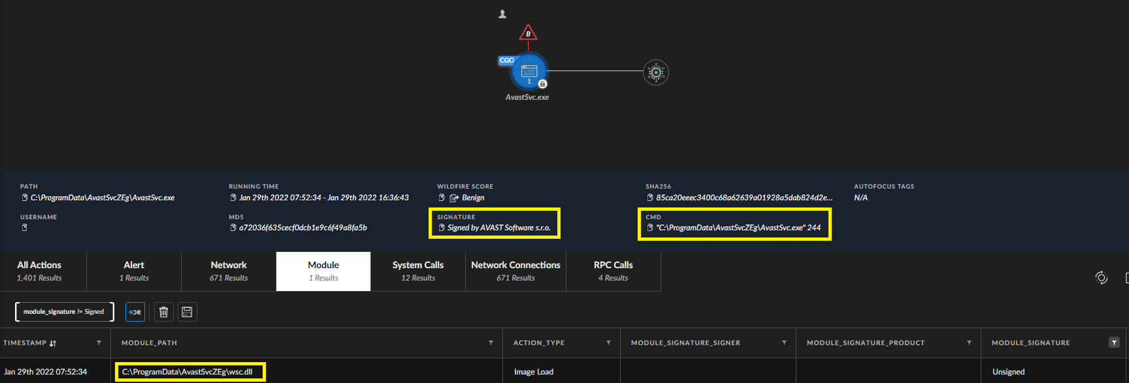
Legitimate Avast Process?
Observed a suspicious behaviour of Avast software loading an unsigned DLL
DLL hijacking technique is used in order to load the payload into the memory of benign applications

Slide 18
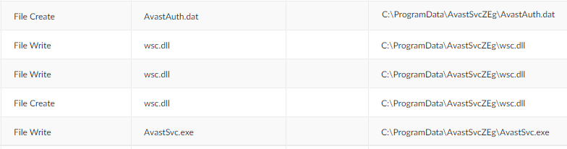
PlugX RAT
The loaded DLL was recognized as the PlugX RAT
Capabilities: - Keylogging - Information stealing - Files modification
Contains 3 files: - Benign executable - DLL loader - Encrypted payload (.dat file)

Slide 19
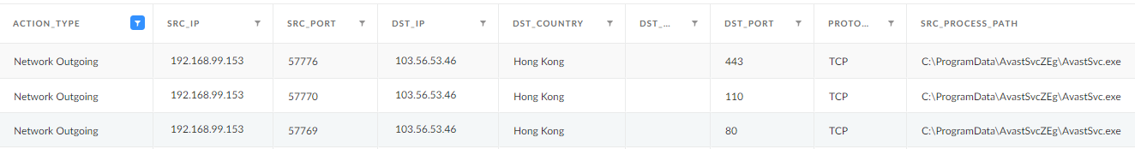
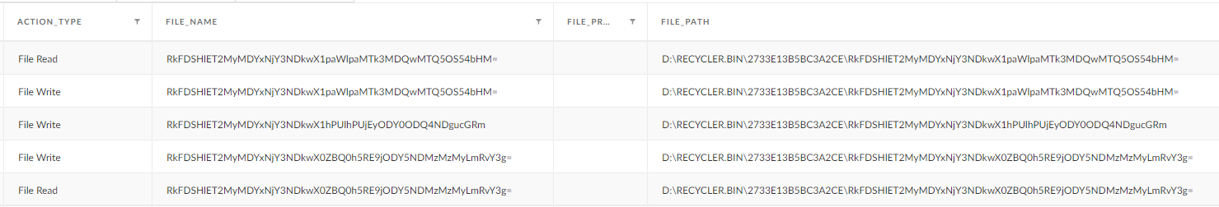
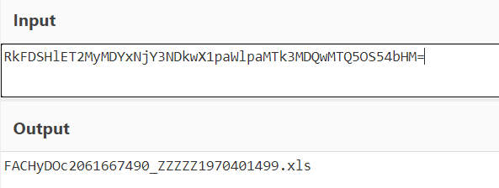
Additional functionality
Registry Persistence
Spreading via USB and file shares
C2 Communication
Files exfiltration

Slide 20
Let’s Hunt

Slide 21
Common-Grounds
Unprivileged paths -
C:\Users
C:\ProgramData
PE Entropy
I.e - All Raspberry Robin payloads share the same entropy
Anomalies - Frequency of execution -
By command line
By module load

Slide 22
Questions?

